Slide 1
Toxicological agents & chemicals
Chapter 2.2.
Petar Bulat, MD, PhD,
University of Belgrade
9/9/2012

Slide 2
Content
Basics of occupational toxicology
Information sources on hazardous substances
Routes of exposure
Excretion
Exposure assessment
Occupational toxicology
Occupational toxicology of mineral dusts
Occupational toxicology of metals
Occupational toxicology of gases
Occupational toxicology of organic solvents
Prevention of toxic effects of hazardous chemicals

Slide 3
Information sources on hazardous substances
Material Safety Data Sheet (MSDS)
Toxicology Data Network (TOXNET)
Haz-Map
Chemical Carcinogenesis Research Information System

Slide 4
Routes of exposure
Gastrointestinal tract (ingestion)
Lungs (inhalation)
Skin (topical, percutaneous, or dermal)
Parenteral (other than intestinal canal) routes.

Slide 5
Routes of exposure
To exert a systemic toxic effect, a hazardous substance must first enter the circulation by crossing the body’s natural barriers. The two main ways this can occur are:
Passive diffusion
Active transport

Slide 6
Excretion
The main routes of excretion of hazardous substances are:
Renal (via the kidneys) - for small, water-soluble molecules
Biliary (via the liver and GIT) - is the second most important route of elimination of substances from the body, and for some materials (such as lipid soluble) may be the most important.
Pulmonary (exhalation via the lungs) - an important route of excretion for volatile substances.
Secretory (in fluids such as sweat, semen, tears) - a minor route

Slide 7
Exposure assessment
Exposure assessment is the process of estimating or measuring the magnitude, frequency and duration of exposure to an agent.
It could be performed through two basic concepts:
Ambiental (environmental) monitoring
Biological monitoring

Slide 8
Ambiental Monitoring
Measurement of an exposure to an agent in:
General workroom ambient
Specific operation
Worker’s breathing zone

Slide 9
Ambiental Monitoring
Continuous monitoring
Integrated sampling
Grab (spot) sampling

Slide 10
Continuous Monitoring
Provides real-time measurement of contaminant concentration.
Three different types:
Stationary installations with multipoint monitoring capability
Field monitoring instruments (handheld)
Personal monitors

Slide 11
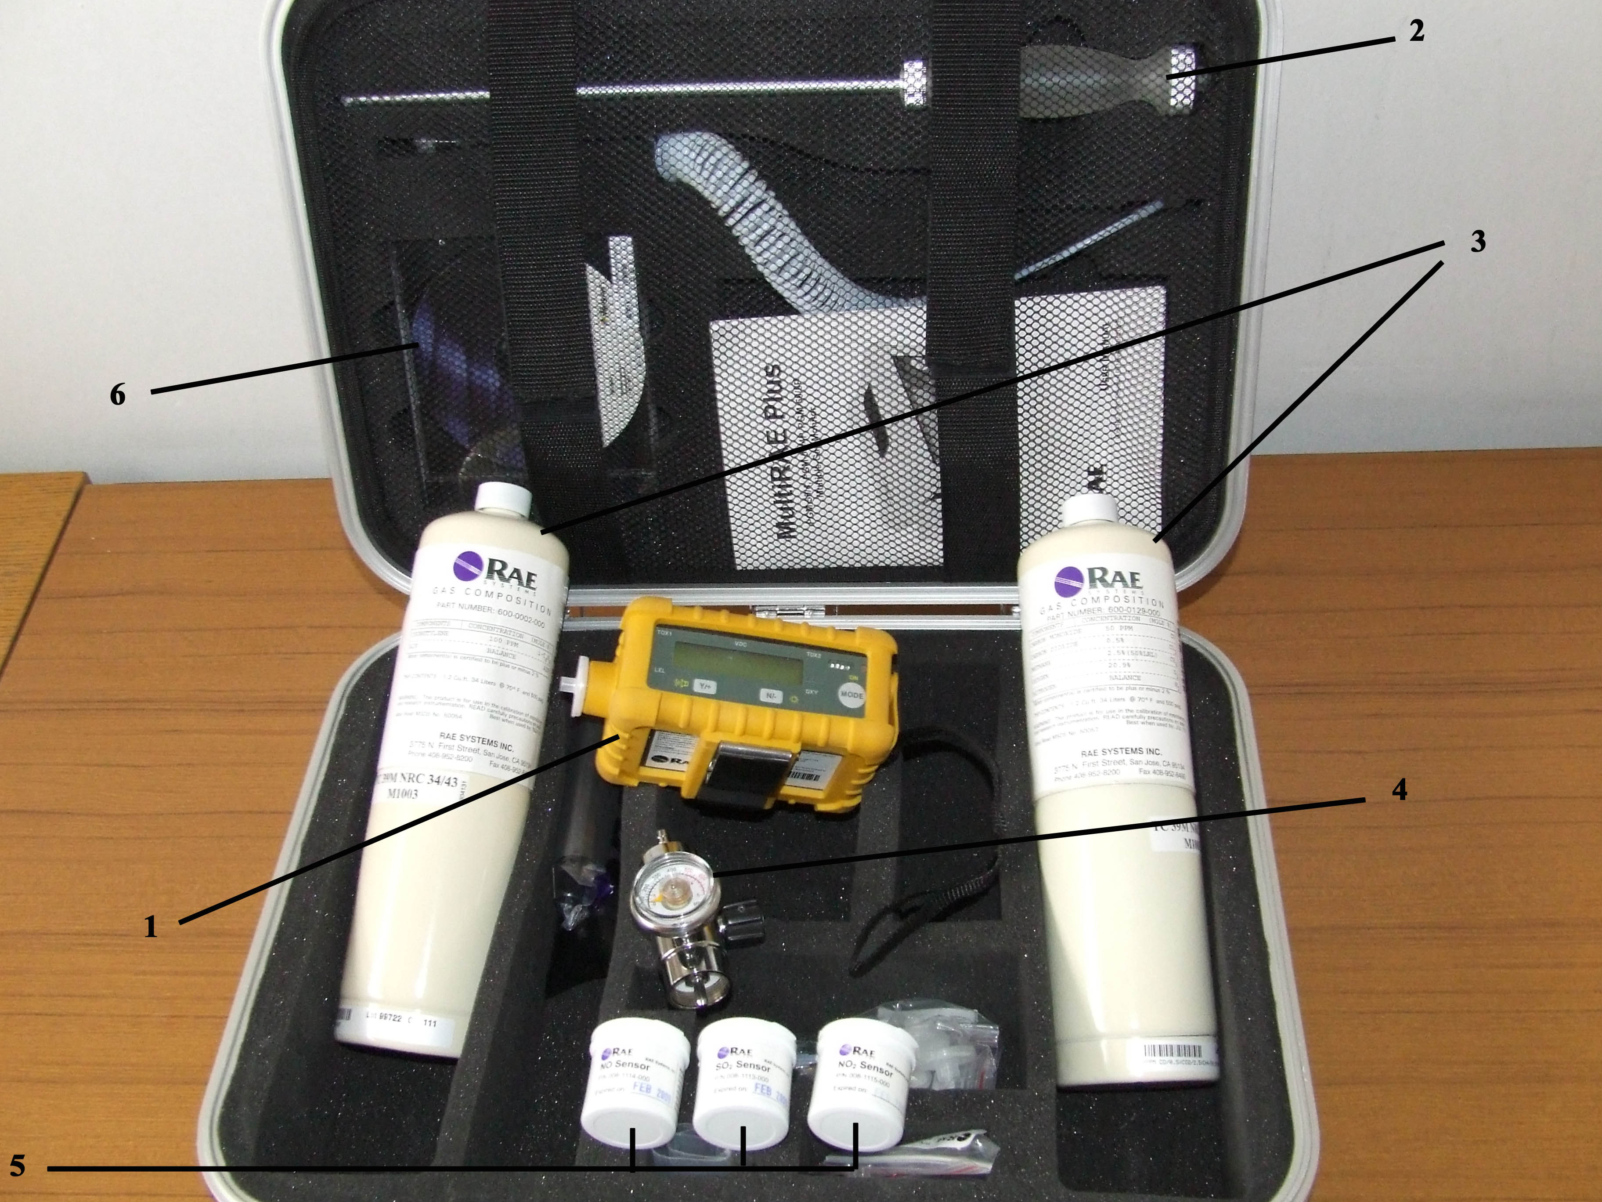

Slide 12
Integrated Sampling
Based on collection (and concentration) of sample over period of time to obtain the average exposure in sampling period (operation, whole shift…).
Active sampling
Passive sampling

Slide 13
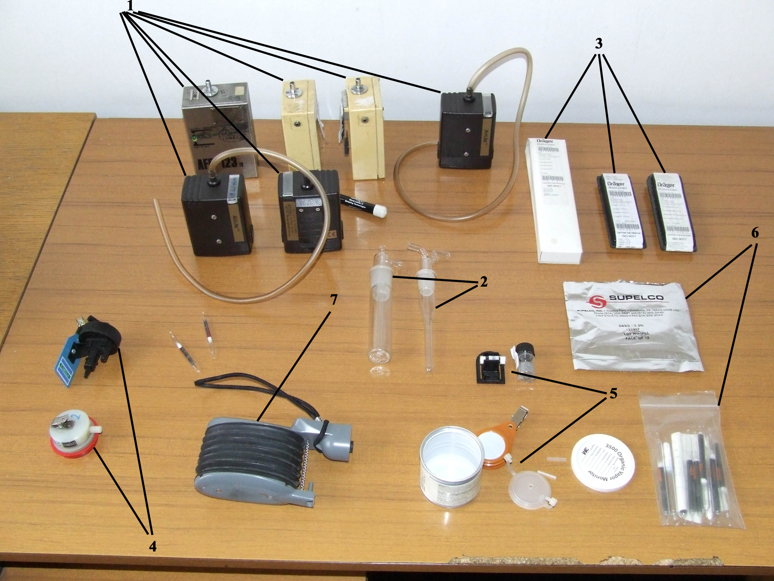

Slide 14
Grab (spot) Sampling
Based on collection of sample at a point in time to evaluate peak exposures.
Grab sampling is also used to:
Measure exposure in intermittent processes
Identify unknown contaminants
Evaluate sources of contamination

Slide 16
Biological Monitoring
Measurement conducted in biological sample that evaluate an exposure or biologic effect of that exposure.

Slide 17
Biomarkers
Exposure
Effect
Susceptibility

Slide 18
Biomarkers
Biomarkers of Exposure
Biomarkers of Effect
Metabolite
DNA-Adducts
Somatic Mutation
Hyperplasia
Internal Dose
Biologically Active Dose
Early Biological Effect
Altered Structure/ Function
Clinical Defects
Exposure
Susceptibility
Wiliam N. Rom. Environmental & Occupational Medicine. 178:1998

Slide 19
Biomarkers of Exposure
Measurements of toxin or its specific metabolite in biological sample.
Examples:
Blood lead level
trans,trans-Muconic acid in urine (benzene metabolite)
Ethanol in exhaled air

Slide 20
Biomarkers of Effect
Measurement of biological response leading to injury or disease caused by exposure.
Examples:
Acetyl-cholinesterase activity (in case of organophosphate pesticide exposure)
Erythrocyte protoporphyrine level (in case of lead exposure)
Urine β₂ microglobuline level (in case of cadmium exposure)

Slide 21
Biomarkers of Susceptibility
Indicators signaling unusually high sensitivity to certain exposure.
Exaples:
Activity of enzymes involved in xenobiotic biotransformation (GST, NAT)
Activity of cell DNA repair mechanisms

Slide 22
Ambiental vs. Biological Monitoring
 | Ambinetal monitoring | Biological monitoring
Includes all sources of exposure | - | ++
Excludes exposure-modifying external factors | - | +
Accounts for individual differences in uptake | - | ++
Influence of individual differences in the xenobiotic biotransformation | - | ++
In case of multiple agents exposure could provide summary measure | +/- | +
Availability | ++ | +/-
Price | + | -
Specificity | ++ | +/-
Sensitivity | + | +/-

Slide 23
Ambiental vs. Biological Monitoring
 | Ambinetal monitoring | Biological monitoring
Integration of past exposure | - | +
Peak values | + | -
Active participation and collaboration of sampled worker | + | -
Manipulating samples | +/- | +/-
Invasive | + | -/+
Immediate results | + | -

Slide 24
Occupational toxicology of mineral dusts-Asbestos
Asbestos is the term for a group of naturally occurring hydrated silicate minerals. The term asbestos is applied to six such minerals that can be grouped into two main categories:
Serpentine group
Chrysotile (white asbestos)
Amphibole group
Amosite (brown asbestos)
Crocidolite (blue asbestos)
Anthophyllite, Tremolite and Actinolite

Slide 25
Occupational Exposure to Asbestos
Processes which includes demolishing and/or repair of:
Pipe and boiler lagging
Thermal and acoustic insulation
Insulation boards for fire protection, wall and ceiling panels
Asbestos cement products: corrugated or flat sheeting, rainwater pipes, gutters, tiles, cladding, flues etc.

Slide 26
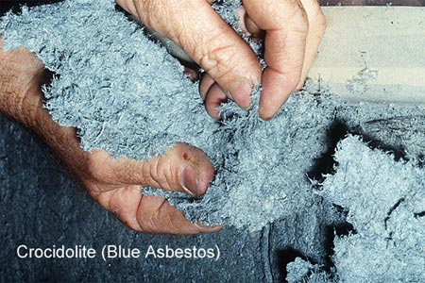
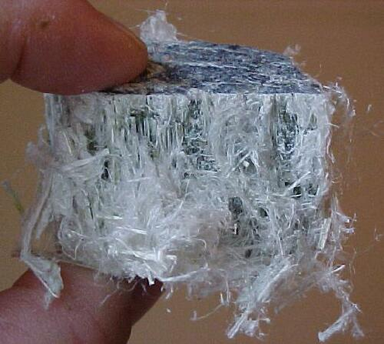
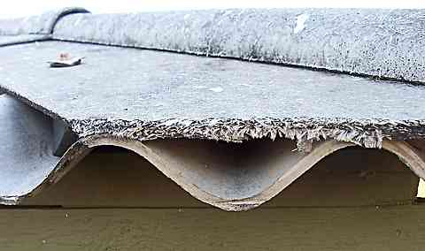
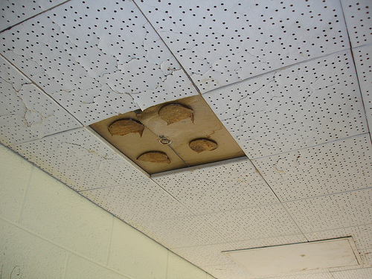

Slide 27
Asbestos Health Effects
Asbestosis-fibrotic pneumoconiosis that causes a progressive loss of elasticity and lung function, normally over many years of asbestos exposure.
Mesothelioma-malignant growth in the pleura or more rarely the peritoneum (it may develop any time from 15 to 50 years after the first exposure to asbestos).
Lung cancer-increased risk in smokers exposed to asbestos.

Slide 28
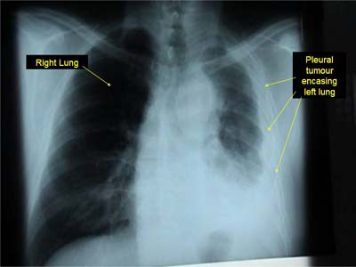

Slide 29
Occupational toxicology of metals Cadmium
Cadmium occurs naturally as cadmium sulphide with zinc blende. It is produced as by-product in zinc, lead and copper production.

Slide 30
Exposure to Cadmium
The most important occupational exposures occur during:
Cadmium smelting
Steel alloys production
Recycling of electronic waste
Cigarette smoking is a significant source of cadmium exposure in the general population.

Slide 31
Cadmium route of exposure
The main route of cadmium exposure is inhalation (in case of cadmium fumes absorption may reach 40-60% of inhaled cadmium).
Through digestive system only 5% of ingested cadmium is absorbed (in children it could be significantly higher).

Slide 32
Cadmium toxicokinetics
Once taken up by the blood, the majority of cadmium is transported bound to proteins, such as Albumin and Metallothionein.
After uptake cadmium is mainly stored in the liver and kidneys.
In case of exposure cessation cadmium liver body burden tends to decrease by shifting to the kidneys.
Cadmium has an extremely long half-life (15-30 years) so it may be detected a long time after exposure has occurred.

Slide 33
Cadmium toxicodynamics
Cadmium toxic effects are linked to its reaction with enzyme sulfhydryl groups and consecutive enzyme activity inhibition.
Due to decreased activity of enzymes involved in metabolism and consecutive lack of energy a number of processes in cells are affected.
It has to be mentioned that disturbances of cell metabolism leads also to free radical production and lipid peroxidation damage of cell membranes.

Slide 34
Cadmium Health Effects
Acute inhalation of cadmium oxide fumes-irritation of respiratory system.
High exposure to cadmium oxide fume-chemical pneumonitis and oedema in the lungs, which can be fatal.
Chronic cadmium exposure leads to emphysema caused by decreased activity of α1-antitripsine.
Longterm exposure to cadmium leads to kidney damage. Due to accumulation of cadmium in tubular cells and consecutive lack of energy and damage of tubular cells membranes occurs, leading to damage of tubular reabsorption of calcium, phosphate, amino acids, and some low molecular weight proteins (α1-microglobuline and β2-microglobuline).
Cadmium is a human carcinogen causing lung cancer.

Slide 35
Cadmium Biological Monitoring
Blood cadmium levels indicate recent exposure to cadmium
Urine cadmium indicate body burdens, although urine levels do respond somewhat to recent exposure.
According to American Conference of Governmental Industrial Hygienists recommendation urine cadmium should be below 5 μg/g creatinine and blood cadmium below 5 μg/L.

Slide 36
Cadmium Therapy
Some of the chelating drugs that are beneficial for other toxic metals actually increase cadmium toxicity by mobilizing the cadmium and substantially increasing the renal concentrations and toxicity.
It seems that Monoisoamyl meso-2,3-dimercaptosuccinate (Mi-ADMS) was an effective chelating agent for reduction of kidney and liver cadmium when administered either parenterally or orally.

Slide 37
Occupational toxicology of gases
For the purpose of occupational toxicology gases are divided in the following groups:
Asphyxiants
Simple asphyxiants: Nitrogen, Methane, Argon.
Chemical asphyxiants: Carbon monoxide, Carbon dioxide, Hydrogen cyanide
Irritants
Upper respiratory tract irritants : Chlorine, Ammonia
Lower respiratory tract irritants : Nitrous oxides

Slide 38
Simple asphyxiants
These gases cause adverse health effects by simple asphyxia.
Their effects are the consequence of decreased oxygen level in local atmosphere caused by increased concentration of one of the gases from this group.
If the level of oxygen in the air is reduced below 14% it will cause rapid breathing and tissue damage followed by loss of consciousness and death as oxygen levels reduce further.
Patients intoxicated by simple asphyxiants should be treated with oxygen therapy.

Slide 39
Chemical asphyxiants
Chemical asphyxiants are a heterogenous group and each member has its own mechanism of action which at the end leads to asphyxia.
Carbon monoxide is a typical representative for the whole group.

Slide 40
Carbon monoxide
Carbon monoxide is a colorless, odorless gas that is produced by the incomplete combustion of organic compounds.
It binds very strongly to haemoglobin, leading to elevated carboxyhaemoglobin levels and consequently a diminished oxygen-carrying capacity of the blood.

Slide 41
Carbon monoxide
Acute health effects include giddiness, headache and muscle weakness.
In case of fatal carbon monoxide intoxications victims are quite often found on the ground near doors or windows. It is due to their attempt to open a door or window but due to extreme muscle weakness they could manage it.
In heavily exposed patients hypoxia causes brain damage with memory loss. Also, hypoxia could cause acute heart failure.
Therapy: Patients intoxicated by carbon monoxide should be treated with oxygen therapy as well as other symptomatic and supportive therapy.

Slide 42
Irritants
The somewhat arbitrary division into upper and lower respiratory tract irritants is largely based on the solubility.
Highly water soluble gases, such as ammonia, chlorine and sulphur dioxide, exert their main irritant effect on the conjunctiva and upper respiratory tract. This, unless the exposure is prolonged and severe, saves the lungs.
Conversely, gases of low solubility, such as nitrogen oxides and phosgene, have little effect on the upper respiratory tract; their effect is delayed and the main consequence is more or less serious lung damage.

Slide 43
Chlorine
Upper respiratory tract irritant. It is used in chemical and pharmaceutical production, water disinfection in swimming pools and water supply as well as in plastics manufacture.
Chlorine reacts with tissue water forming hydrochloric acid, which can cause severe tissue damage in high concentrations.
Acute health effects include severe upper respiratory tract irritation leading to pulmonary oedema and death in those unable to escape its effects. Recovery from an acute exposure may be prolonged.
Chronic effects include bronchitis.
Therapy: Patients intoxicated by chlorine should receive supportive therapy including bronchodilatator therapy. In case of pulmonary oedema high-flow oxygen therapy should be administered.

Slide 44
Nitrogen dioxide
Lower respiratory tract irritant. It is used in the manufacture of nitric acid, explosives and jet fuel. It is also generated during some types of welding and diesel engine operation.
Acute health effects of nitrogen dioxide exposure are insidious, due to slow progression of pulmonary irritation some 8 - 24 hours after exposure. Severe exposure can result in death from pulmonary oedema within 48 hours.
Therapy: Intoxicated patients should be carefully monitored at least 48 hours after the exposure. They should receive symptomatic and supportive therapy. In case of pulmonary oedema high-flow oxygen therapy should be administered.

Slide 45
Occupational toxicology of organic solvents
Solvents are substances that are capable of dissolving or dispersing one or more other substances. They are a heterogeneous group of substances including:
Aliphatic hydrocarbons
Aromatic hydrocarbons
Alcohols
Amines
Esters
Ethers
Ketones
Nitrated or chlorinated hydrocarbons
Other

Slide 46
Occupational toxicology of organic solvents
A number of workers around the globe are exposed to organic solvents used in: paints, varnishes, lacquers, adhesives, glues, and degreasing/cleaning agents, and in the production of dyes, polymers, plastics, textiles, printing inks, agricultural products, and pharmaceuticals. One might assume that almost there is no profession which has not occasional exposure to organic solvents.
Many organic solvents are recognized as:
Carcinogens (e.g., benzene, carbon tetrachloride, trichloroethylene),
Reproductive hazards (e.g., 2-ethoxyethanol, 2-methoxyethanol, methyl chloride),
Neurotoxins (e.g., n-hexane, tetrachloroethylene, toluene).

Slide 47
Occupational toxicology of organic solvents
The risk to health from exposure to a solvent will depend on a number of factors including toxicity, exposure level and volatility.
The rate of evaporation of different solvents varies widely. An indication of volatility is given by the vapour pressure – the higher the vapour pressure the greater the potential for significant generation of vapour.
Solvent vapours are heavier than air and in a still environment a saturated vapour cloud will tend to sink towards the floor. However, high concentrations can build up within storage tanks or sumps where air movement is restricted or when large quantities of solvent vapour are released.

Slide 48
Occupational toxicology of organic solvents
Organic solvents are generally absorbed by two main routes of entry:
Inhalation of the solvent vapour
Skin absorption.
Solvent vapours are rapidly absorbed through the lungs and enter the bloodstream (causing systemic effects on target organs).
Solvents in contact with the skin can cause local effects as well as being absorbed through the skin into the bloodstream.

Slide 49
Occupational toxicology of organic solvents
Acute health effects are like in acute alcoholism.
In the first phase, excitation: the exposed person is hyperactive; he is laughing and singing.
In the second phase, depression symptoms like headache, drowsiness, nausea and dizziness occurs.
In case that exposure continues the person will lose consciousness.
Most severe intoxication is followed by coma and might be fatal.

Slide 50
Occupational toxicology of organic solvents
Chronic exposure to organic solvents leads to its chronic adverse health effects.
In case of dermal exposure, skin manifestation may include dermatitis, hyper or hypopigmentation of skin, allergic manifestations etc.
Chronic exposure to organic solvents may cause liver and kidney damage; almost all kinds of haematological changes (decreased or increased number of erythrocytes, leucocytes and thrombocytes).
Quite often as manifestation of peripheral nervous system damage patients are suffering from peripheral neuropathy.
Brain damage is developing insidiously through years of organic solvents exposure. First symptoms like sleepless, nervousness, light depression are rarely recognized. Usually, organic solvents adverse health effects are recognized when more prominent symptoms like irritability, sleep disorders, dementia occurs.

Slide 51
Occupational toxicology of organic solvents
Since the exposure to organic solvents in developed countries is decreasing more attention is directed towards other chronic effects like carcinogenesis, mutagenesis and effects on reproductive system. There are a number of organic solvents identified as carcinogens. One of the most common is benzene, responsible for leukemia and probably non Hodgkin Lymphoma.

Slide 52
Prevention of toxic effects of hazardous substances
Prevention of toxic effects of hazardous substances is extremely important. This process demands multidisciplinary team work and occupational health specialists have an important role in this process. In occupational health and safety prevention there is a universally accepted hierarchy of measures:
Elimination
Substitution
Isolation
Segregation
Engineering controls
Administrative controls
Personal protective equipment
Housekeeping : provide training, signage – warning

Slide 53
Elimination – Substitution
The most effective form of prevention is simply elimination of the hazardous substance or the whole process in which it is used. However, this is not often applicable, but quite often a hazardous substance can be substituted with a less toxic one. The most well known substitutions are:
Benzene replaced with toluene
Trichloroethylene replaced with Perchloroethylene or n-propyl bromide
Carbon tetrachloride replaced with methyl chloroform
Asbestos replaced with synthetic and ceramics materials

Slide 54
Isolation
Wherever it is possible processes or operations in which exposure to hazardous substances might occur should be completely enclosed.

Slide 55
Segregation
When isolation is not an appropriate measure, hazardous processes or operations can be segregated from lower risk ones by placing them in a separate room, or in a separate building thereby minimizing the number of workers at risk.

Slide 56
Engineering Controls
In case that in processes it is impossible to implement the above mentioned measures or in case that they are insufficient there is always possibility to implement engineering controls based on local and general ventilation.
Local Exhaust Ventilation is based on capturing contaminants near to the source of emission or application and its elimination to a safe location or further processing and in some cases returning to a process. This measure is particularly valuable for situations that involve a point source release of toxic contaminants.
General / Dilution Ventilation is widely used throughout industry for the ventilation of processes with low risk for hazardous substance exposure. It is not suitable for the control of dust, mist of fume or for substances of moderate to high toxicity, or in situations where the rate of generation of contamination is non-uniform or high.

Slide 57
Administrative Controls
Administrative controls relate to how the interaction between personnel and the process/operation are organised. Great care is needed to ensure that procedures, once adopted, are observed.
Sometimes the hazardous operation can be conducted during the evening or night shift when fewer workers are around to be exposed.
Job rotation is another method of „protecting” personnel, through controlling work patterns.
The workers can often influence the extent to which they are exposed to airborne contaminants, e.g. for welding, via stance and/or working upwind of the weld.

Slide 58
Personal Protective Equipment (PPE)
PPE is normally considered to be the last measure in prevention of adverse health effects of hazardous substances.
In case that all preceding measures are insufficient or not reasonably practicable in achieving a satisfactory workplace environment personal protective equipment should be implemented.
It is important that the protection is effective and comfortable; most personal protective equipment is not comfortable for extended use.

Slide 59
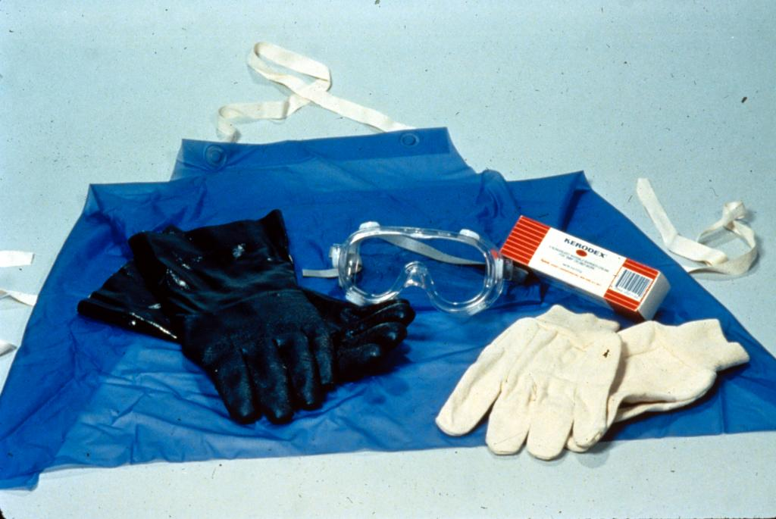
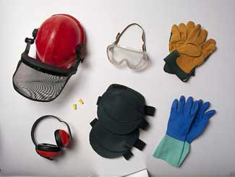
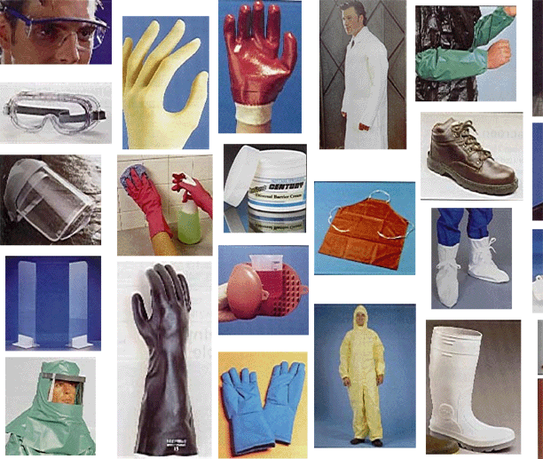

Slide 60
Housekeeping
Good housekeeping is particularly important in processes and laboratories where hazardous materials may be handled. Clear labelling, with relevant health and safety advice, careful and appropriate storage and good work techniques all need to be addressed. Proper preventative maintenance schedules and regular inspection/leak detection of process plant; plus frequent maintenance, examination and testing of engineering controls are essential if effective control is to be achieved and kept.
Education of employees on health hazards in the workplace and the importance of correctly using all the control measures provided, adopting recommended operating procedures and wearing personal protection, if required, is needed in order to minimise the risk to health.

Slide 61
Don’t forget the WARP
Work : could the work of the patient be (part of) the cause or the aggravation of his/her complaint or disease?
Skin lesion in worker exposed to organic solvents
Lung firbrosis in asbestos exposed worker
Activities : could the complaint / disease of the patient have consequences for his/her activities and participation in work
Liver disease in worker exposed to organic solvents
Chronic obstructive pulmonary disease in worker exposed to chlorine
Referral : should I refer my patient to an occupational physician or another specialist
Should cadmium exposed worker with emphysema, take specific precautions?
Prevention : Can I do something to prevent the (return of the) complaint or disease?
Is there a need for trichloroethylene replacement in dry cleaning shop?

